Slide 1
Quality Improvement Projects
Jessica Abbey, Education and Quality Scholar

Slide 2
Objectives
What is Quality Improvement?
How does QI compare to Audit?
Choosing a project
Understanding the problem and collecting baseline data
Writing SMART Aims
PDSA Cycles
Summary and Reflection
QIP Examples

Slide 3
RCGP Curriculum
During your GP training you are expected to complete a Quality Improvement Project (QIP) when you are in your primary care placement in either ST1 or ST2 and a Quality Improvement Activity in any other training year.
RCGP curriculum (2018) says:
‘Knowing and applying the principles of lifelong learning and quality improvement should be considered an essential competence for every GP.’

Slide 4
What is Quality Improvement?
‘Quality improvement is about giving the people closest to issues affecting care quality the time, permission, skills and resources they need to solve them. It involves a systematic and coordinated approach to solving a problem using specific methods and tools with the aim of bringing about a measurable improvement.’
https://www.health.org.uk/sites/default/files/QualityImprovementMadeSimple.pdf

Slide 5
‘Through quality improvement there is the potential to create a health care service capable of ensuring ‘no needless deaths; no needless pain or suffering; no helplessness in those served or serving; no unwanted waiting; no waste; and no one left out’.
Berwick D. No needless framework. Boston: Institute for Healthcare Improvement, 2010

Slide 6
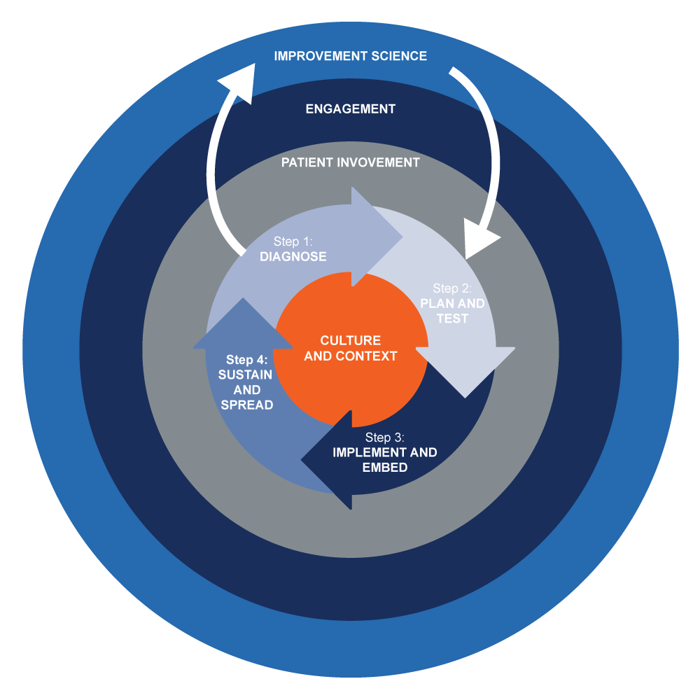
Notes:
QI Wheel For Primary Care a simple visual representation that illustrates the the main elements to consider in design, delivery and evaluation of a QI project, acting as a guide to the stages involved.

Slide 7
How can we describe quality?
Timely
Efficient
Safe
Person-Centred
Effective
Equitable
Notes:
Safe: avoiding harm to patients
Timely: reducing waiting times and sometimes harmful delays
Effective: providing services based on evidence and which produce a clear benefit
Efficient: avoiding unnecessary waste
Equitable: providing care that does not vary in quality because of a person’s characteristics
Person-Centered: establishing a partnership between practitioners and patients to ensure care respects patients’ needs and preferences

Slide 8
Types of Improvement:
Reducing defects from the viewpoint of the patient or carer – this focuses on the quality of all aspects of the service being provided
Reducing cost/waste to improve efficiency
Providing a new product or service or an old one at an unprecedented level
Notes:
First point: could be looking at the patient journey and patient experience. Could be taking a more holistic approach
Third point: – this focuses on new attributes that can exceed the patient or carer’s expectations. For example, bringing new research into practice or the use of innovative technology.
For the purpose of your QIP in GP training – often it is looking a patient safety – but you could also look at staff experience and the environment as this has an indirect impact on patient safety

Slide 9
What does quality improvement involve?
Quality improvement draws on a wide variety of approaches and methods, although many share underlying principles, including:
• identifying the quality issue
• understanding the problem from a range of perspectives, with a particular emphasis on using and interpreting data
• developing a theory of change
• identifying and testing potential solutions; using data to measure the impact of each test and gradually refining the solution to the problem
• implementing the solution and ensuring that the intervention is sustained as part of standard practice.

Slide 10
QIP vs Audit
Can anyone list any similarities or differences between QIP and Audit?

Slide 11
QI vs Audits How they are the same:
Both look at the quality of care provided with the aim of improving
Both require measurements to demonstrate change
An Audit can be part of Quality Improvement and can be used as a measure
Notes:
https://www.ncbi.nlm.nih.gov/pmc/articles/PMC5673151/

Slide 12
QIP vs Audit How are they different:
QIP vs Audit How are they different:
AUDITS
An audit assesses if a certain aspect of health care is attaining a recognized standard – based more on quality assurance
An audit has set criteria, each with their own defined standards, and has two sets of measurements over a longer time period, to demonstrate a baseline and then improvement.
Audits tend to have a maximum of one review cycle – often after several months
Do not always lead to sustainable change
QIPs
QIPs can have a different aim, they don’t have to be clinically orientated like audits – they can focus on more holistic issues around patient experience
PDSA cycles have short time spans allowing improvement to be incorporated quickly
QIPs can be about making small incremental changes and measurements which may be done weekly to test the impact of the changes.

Slide 13
How to start?
A good place to start:
https://www.rcgp.org.uk/-/media/Files/GP-training-and-exams/WPBA/QIP/RCGP-QIP-WPBA-feedback-levels-and-word-pictures-200920-pdf.ashx?la=en
Have a look at the RCGP Quality Improvement Feedback Levels that can be found in Fourteen Fish when you enter the QIP entry area. This shows what you are expected to write up in the portfolio and what is expected in each area

Slide 14
Project Title and why it was chosen
Project Aim
Describe what baseline data or information you gathered
How did you plan and test out your changes?
Describe what subsequent data or information you gathered
How have you engaged the team, patients and other stakeholders throughout the project?
Summarise the changes as a result of your work and how these will be maintained.
What have you learnt and have you got any outstanding learning needs?

Slide 15
First: choose a project!
Not sure what to do?
Generate ideas:
- Have you noticed any problems in your practice which you think could be improved?
- Ask your supervisor for ideas or guidance or seek suggestions from the GPs in the practice or the practice manager
What is your interest? What are you passionate about?
Ask other trainees or colleagues about QIPs they’ve done in the past
Sometimes its easier to start with a problem…. If it ain’t broke don’t fix it!
Notes:
Sometimes you can start with the solution …. But the correct and best practice way to do it is start with the problem

Slide 16
Understanding the problem
There are multiple methods to do this through QI tools:
https://www.weahsn.net/toolkits-and-resources/quality-improvement-tools-2/more-quality-improvement-tools/
Root-cause Analysis – the 5 whys?
Process Mapping
Fishbone Analysis
Surveys
Notes:
So next we’re going to focus on better Understanding the problem – the problem being what you want to improve as part of your QI project. To better understand your problem you need to understand the cause or causes better. This is ultimately going to help you come up with better solutions.
There are multiple methods to do this through QI tools.I’ve included a link here to a really useful website which details quite a few of these tools. And I’ve listed some of these below, and we’re going to look into some of these in a bit more detail.

Slide 17
The duty doctor list has increased by 50% in the last two weeks
The 5 Whys
WHY?
The reception team have booked extra patients onto the duty doctor list instead of giving them a routine appointment
WHY?
The extra cases have been booked by two new reception staff who have recently jointed the practice
WHY?
The new reception staff have not completed their induction training, so are not familiar with the triage process
WHY?
The lead reception staff member who delivers induction training has been off sick
WHY?
Root Cause
Now start to think of solutions
Notes:
Root-cause Analysis – the 5 whys
Five whys (5 whys) is a problem-solving method that explores the underlying cause-and-effect of particular problems.
The primary goal is to determine the root cause of a problem by successively asking the question “Why?”. The number ‘5’ here comes from the anecdotal observation that five iterations of asking why is usually sufficient enough to reveal the root cause.
In some cases, it may take more or fewer whys, depending on the depth of the root cause.

Slide 18
Process Mapping
Process mapping is a tool used to chart each step of a process. Process mapping creates a visual representation of all the steps in a process. It is best created by a group of people involved in the process.
Notes:
https://equiptowerhamlets.nhs.uk/stage-1/
Process maps show how things actually happen, rather than what ideally should happen
This is useful as it can help us pinoint areas where problems are occurring, or areas of inefficiency that could be improved

Slide 19
Fishbone Analysis
ENVIRONMENT
MATERIALS
CAUSES
PEOPLE
PROCESS
PROBLEM
EQUIPMENT
MEASUREMENT
Notes:
Fishbone looks at possible causes of a problem. It does this by looking at different categories as show in the above diagram. You can use this tool to identify what areas you want to focus on as part of your project. Identifying the correct causes of the problem will improve your success in making a change.
Example:
So lets have a think about the example we have been exploring already with the duty doctor list and the triage process.
Our problem here is that the duty list is becoming too long and not manageable.
Now lets break this down into different possible causes
Environment – outbreak of covid resulting in more patients calling for clinical advice
- May be an increasing patient population due to new housing estate being built
People – not enough doctors or nurse practioners to manage the increasing list
Process – As we looked at in the example before – the reception staff had not had sufficient triage training
Equipment – the computer equipment is old and Systemone or Emis is slow, which is causing delays for the doctors in their work

Slide 20
Collecting Your Baseline Data
You need to collect your baseline data as the starting point for your measurement for improvement
Do this early on in your project so that you have plenty of time to demonstrate change

Slide 21
Lets Recap:
You’ve identified a problem
You’ve analysed this problem and identified a cause or multiple causes that you think you can change
You’ve collected your baseline data from which your subsequent measurements will inform a change

Slide 22
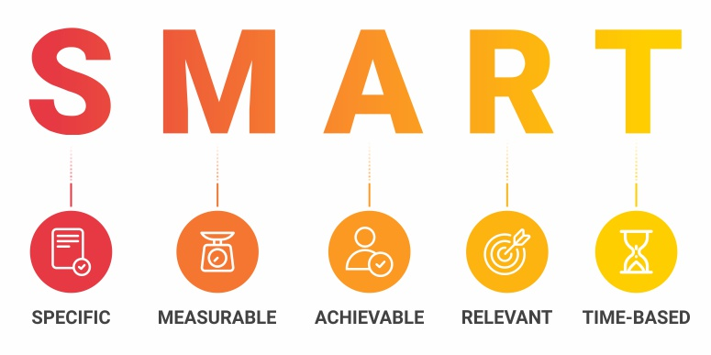
Write your AIM
Notes:
Specific: don’t make it too big or too broad. Focus on something specific, the more specific the easier it will be to achieve
Measurable: you need to be able to collect measurable data to show your change and evidence your improvement. This can be qualitative or quantitative
Achievable: Pick something that you will be able to get results quickly and do regular data collection for. If you’re overambitious it may become too complicated, and you’ll struggle to finish it or get measurable significant results
Realistic/Relevant: have you chosen something that you will be able to easily introduce and see improvement? Is this going to be something that benefits patients and or staff?
Time Specific: think about your time frame. QIPs are meant to be done in your 6 month GP placement in ST2. So don’t start too late and do something that can be achieved in this time frame

Slide 23
Stakeholder Engagement
Who are stakeholders?
Why is stakeholder engagement important?
Notes:
Who will be affected by any change proposed
Who will be involved in the implementation of the change
Who will be responsible for ensuring that any changes will be sustained when you leave.
Who may you need for advice
Anyone who you think needs to be involved or affected by the project.
Examples: - other doctors, administrative staff, practice manager, pharmacists, health visitors, nursing team and patients
This will make up part of your baseline data collection and is a good way to understand the problems and give you ideas about what can be done to bring about improvement. It is important to keep the primary care team up to date; this includes those who will be responsible for ensuring sustained change after you leave.
It is important to involve and engage your stakeholders early. This will improve the success and sustainability of your project.

Slide 24
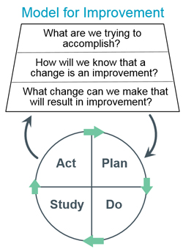
The heart of QI – the PDSA cycle
Aim
Measure
Change

Slide 25
PLAN
1. You’ve identified and analysed a problem
2. You’ve collected you baseline data and started to engage your stakeholders
3. You’ve developed your aim for improvement which is SMART
Now what are you going to do?

Slide 26
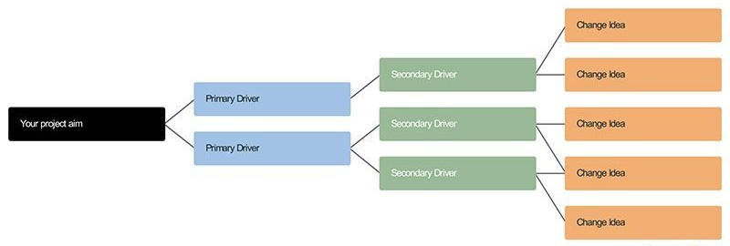
Driver Diagrams
A useful tool to plan your PDSA cycles
Driver diagrams are a type of structured logic chart with three or more levels
These include: a goal or vision; the high-level factors that you need to influence in order to achieve this goal (called ‘primary drivers’); specific projects and activities that would act upon these factors.
Notes:
Another useful tool is a driver diagram. Driver diagrams are a type of structured logic chart with three or more levels (see example below). These would include:
1. The Aim
The driver diagram starts with a clearly defined and measurable goal.
2. Primary Drivers are the factors that you need to influence to achieve the aim.
3. Secondary drivers - The process of breaking down a goal can continue to lower
levels to create secondary or tertiary drivers (and even further
if required).
4. Projects or actions, The ultimate aim of a driver diagram is to define the range of projects (i.e. actual
change initiatives) that you may want to undertake.
Helps avoid silver bullet thinking (one solution solves all) and avoid blind spots

Slide 27
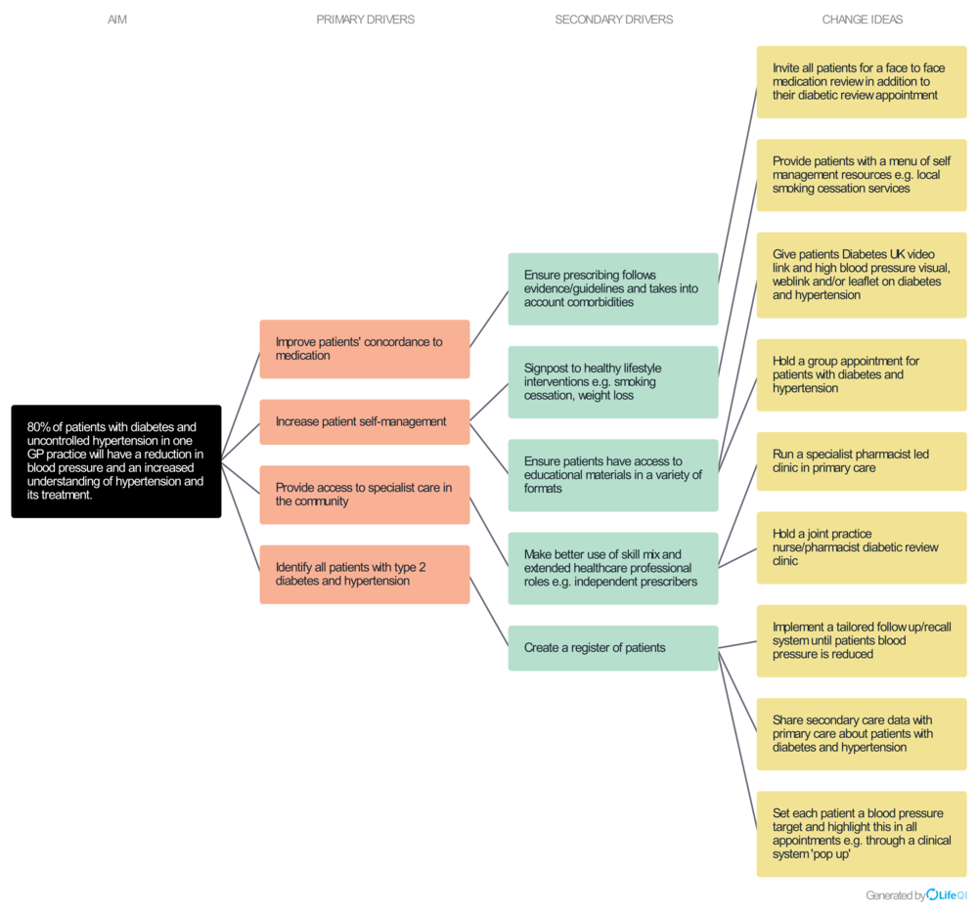
Notes:
https://qilothian.scot.nhs.uk/driver-diagram-1
AIM: 80% of patients with diabetes and uncontrolled hypertension in one GP practice will have a reduction in blood pressure and an increased understanding of hypertension and its treatment
Lets follow the second primary driver: Increase patient self-management
The Secondary drivers include : Signpost to healthy lifestyle interventions eg smoking cessation and weight loss, and Ensure patietns have access to educational materials in a variety of formats
From these secondary drivers come several change ideas which include providing patients with a menu of self management resources, giving patients the Diabetes UK video link and a high BP visual, and holding a group appointment for patients with diabetes and hypertenstion
Can you see how this process has generated multiple ideas from which you can plan your first change?

Slide 28
Planning Continued
Action | Who | When | How
Invite all the affected patients for a face-to-face medication review | Reception Staff | Week commencing 1st Dec 2021 | Via text
Conduct face to face reviews | Doctor | January 2022 | Face to face
Notes:
So what you want to do next to make a clear plan is to make a decision on the action, who will carry out the action, when and how.
Lets use an example from the driver diagram we looked at.

Slide 29
DO
1. You’ve identified and analysed a problem
2. You’ve collected you baseline data and started to engage your stakeholders
3. You’ve developed your aim for improvement which is SMART
4. You’ve made a plan
Now its time to put this plan into action - undertake the change, and document any problems

Slide 30
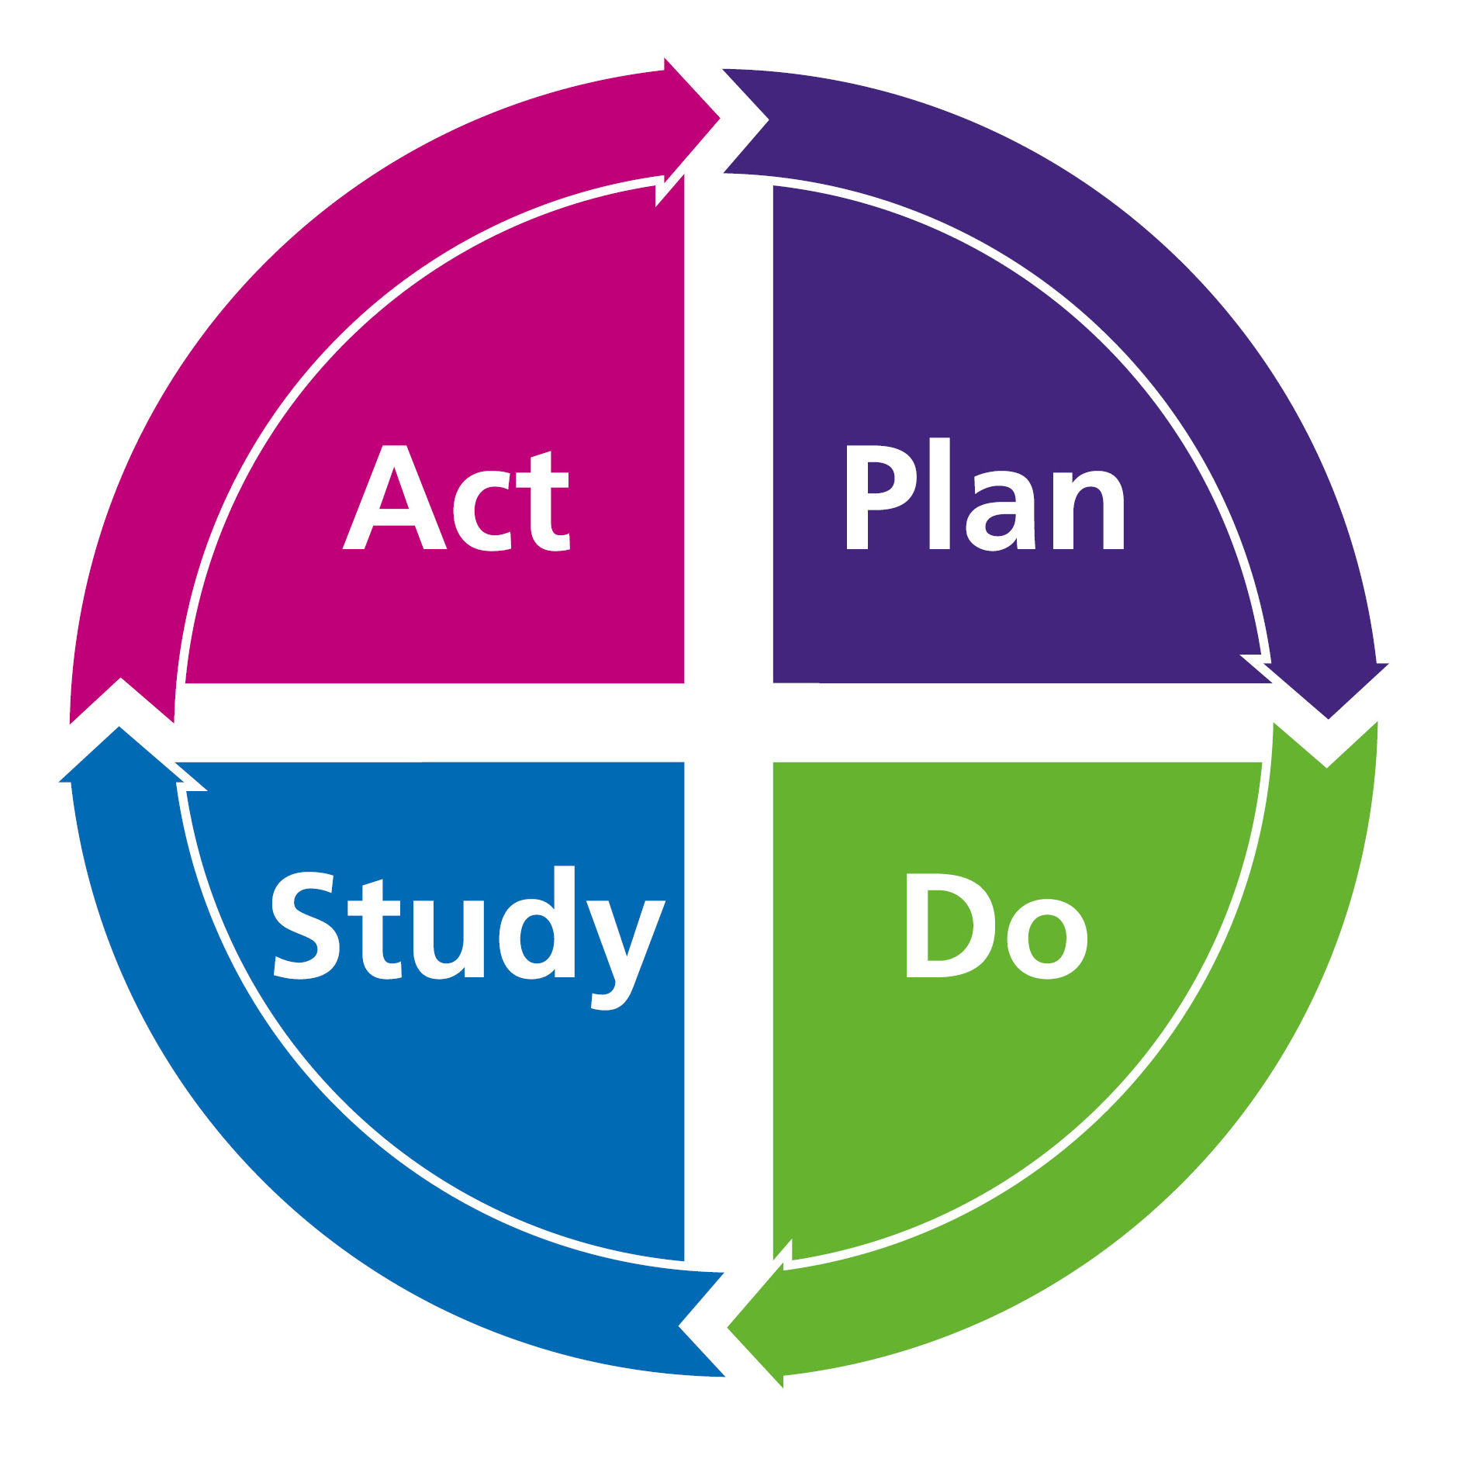
STUDY
1. You’ve identified and analysed problem
2. You’ve developed your aim for improvement which is SMART
3. You’ve collected you baseline data and started to engage your stakeholders
4. You’ve made a plan
5. You’ve put this plan into action
Now you need to measure your results and summarise what was learnt

Slide 31
MEASUREMENT
Measurement can show us a number of important pieces of information:
how well our current process is performing
whether we have reached an aim
how much variation is in our data/process
whether the tests of change have resulted in improvement
whether a change has been sustained.
Notes:
A few things to remember: Not all change leads to an improvement – this is why you need to measure to see effect of change.
Can be quantative (any thing that can be expressed as a number) or qualitative (descriptive data)

Slide 32
Run Charts
A line graph of data plotted over time. Run charts measure data frequently and demonstrate if changes are leading to an improvement
Notes:
An excellent way to show your measurements and demonstrate change is through the use of a run chart.
A run chart is a line graph of data plotted over time. Run charts measure data frequently and demonstrate if changes are leading to an improvement
Median line is the middle number of a set of data and is used in run charts rather than averages to avoid an outlier influencing the results
There are various statistical rules about interpretation of run charts. Most simple states if 6 or more consecutive points either above or below median, or 5 or more consecutive points going up or down suggest significant change

Slide 33
ACT
1. You’ve identified and analysed a problem
2. You’ve collected you baseline data and started to engage your stakeholders
3. You’ve developed your aim for improvement which is SMART
4. You’ve made a plan
5. You’ve put this plan into action
6. You’ve measured your results
Now you need to prepare for the next PDSA cycle – what changes will you make based on the outcome of the first change? Develop a plan for the next cycle to make it better.

Slide 34
Repeated PDSA cycles work towards the AIM
AIM
PDSA
PDSA
PDSA
Data Driven Change
PDSA

Slide 35
Summarise and Reflect
Summarise the changes made as a result of your project.
The change may have been ineffective!
Present your findings to the team at a practice meeting
Reflection - the final process involved reflecting on the process of undertaking a QIP
Notes:
At the end of your project, you should summarise the changes made as a result of your project. This could include exploring why the change has been ineffective. Ideally you should present your findings to the team at a practice meeting and reflect on the process and any feedback you receive. An important part of any quality improvement, especially if the changes have improved quality, is ensuring that the process will continue once you leave the job.
Reflection The final process involved reflecting on the process of undertaking a QIP – what have you learnt, what worked well, how did you work with others and what would you do differently in the future.

Slide 36
Other QIP Examples
Improving follow up for raised platelets on patient blood tests
Reducing the practice carbon footprint by increasing numbers of MDI inhalers prescribed
Improving percentage of 6 week baby checks within 8 weeks
Improving Antibiotic Prescribing for Sore Throats
Monitoring of Novel Oral Anticoagulants in a local GP practice
Investigation and Management of Vitamin B12 deficiency

Slide 37
Useful Resources
RCGP: WPBA assessments (rcgp.org.uk)
RGCP-QI-Guide-260216.ashx (rcgp.org.uk)
RCGP_How_to_do_a_QI_project.ashx
West of England Academic Health and Science Network: https://www.weahsn.net/toolkits-and-resources/quality-improvement-tools-2/
NHS Scotland Quality Improvement Hub: Quality Improvement Zone | Turas | Learn (nhs.scot)

Slide 38
ANY QUESTIONS?

